Slide 1
RENEWIND
Model Tuning PGP - Data Science and Business Analytics Arsalaan B. Saiyed
Date – 22nd July 2022

Slide 2
Contents / Agenda
Executive Summary
Business Problem Overview and Solution Approach
Data Background and Contents
EDA Results
Data Preprocessing
Model Performance Summary
Model Building, Tuning & Selection
Final Model Testing
Building ML Pipeline
Appendices
Appendix-A: EDA Results
Appendix-B: Model Performance Summary

Slide 3
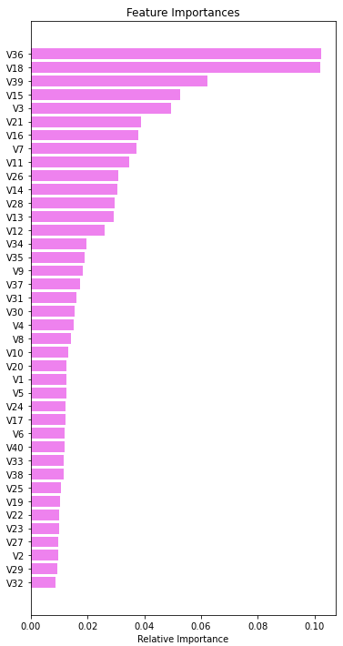
Executive Summary
Insights & Recommendations:
Based on the insights from EDA and building classification models to predict the likelihood of a generator for a wind turbine to fail we would like to provide some insights and recommendations.
On studying the feature importances and plotting some of the estimator decision trees of the final tuned random forest model with the highest recall and accuracy we would like to propose the following:
Variable 36 and 18 (V36,V18) were found to be the top if not one of the top nodes of most of decision tree model and were ranked number one and two in our feature importance list. Therefore, it would be crucial to monitor these features and request for immediate preventive maintenance or repairs if one of the readings were unusual for these variables to avoid replacement costs.
V39,15,3,21,16,7 &11 are important features according to the findings in the feature importance list so we would suggest for inspection of these items if the cost of replacing is high so you can prevent any replacements.
Another suggestion would be to maintain few more fields like dates for when each generator turbine such as ‘generator installation date’, ‘generator failure date(needing replacement)’, ‘number of breakdowns since installation’. Doing this we could predict when a generator is likely due for an inspection, repair or breakdown and extend the lifecycle of a generator as much as possible which would help forecast costs and maintain inventory to minimize as much loss as possible.

Slide 4
Business Problem Overview and Solution Approach
Problem Overview:
“ReneWind” is a company working on improving the machinery/processes involved in the production of wind energy using machine learning and has collected data of generator failure of wind turbines using sensors.
The objective is to build the best machine learning model that will help identify failures so that the generators could be repaired before failing/breaking to reduce the overall maintenance cost. The nature of predictions made by the classification model will translate as follows:
True positives (TP) are failures correctly predicted by the model. These will result in repairing costs.
False negatives (FN) are real failures where there is no detection by the model. These will result in replacement costs.
False positives (FP) are detections where there is no failure. These will result in inspection costs.
It is given that the cost of repairing a generator is much less than the cost of replacing it, and the cost of inspection is less than the cost of repair.
Solution Approach:
Data Overview & EDA
Data pre-processing
Model Building & Comparison
Model Tuning & Testing
Model Pipeline set-up
Executive Summary - Actionable insights and summary

Slide 5
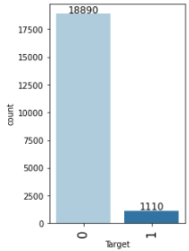
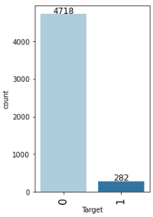
Data Background and Contents
ReneWind provided us with two data sets. Training data and testing data both with 40 variables numbered from V1 to V40 and the target variables; “1” in the target variables should be considered as “failure” and “0” represents “No failure”.
Training Data:
V1 & V2 had 18 missing values each
Testing Data:
V1 had 5 missing values
V2 had 6 missing values
Observations | Variables
20000 | 41
Observations | Variables
5000 | 41

Slide 6
EDA Results
Upon conducting a exploratory data analysis of the raw data for all the 40 variables that whose readings are obtained by the sensors on the wind turbines we see that all the variables have a normal distribution and there was no significant skewness or outliers detected in any of the data except in the target variable. Since information about the actual variables are is confidential we cant derive much insight about the relations or significance of information from the visual analysis but we nevertheless display the statistical summary. Few of the graphs plotted are attached in the appendix.
Note: The mean, min, max etc. for all columns are given in the statistical summary in a table in Appendix-A. Also, note that bivariate analysis is also not possible as we don’t know which of the variables to pair together for analysis or what is their significance. Building a heat map we did see quite a few variables had a strong correlation with each other. The visual is attached in the Appendix slide for reference.
Link to Appendix slide on data background check

Slide 7
Data Preprocessing
Duplicate value check
Missing value treatment
Outlier check (treatment if needed)
Feature engineering
Data preparation for modeling
Note: You can use more than one slide if needed

Slide 8
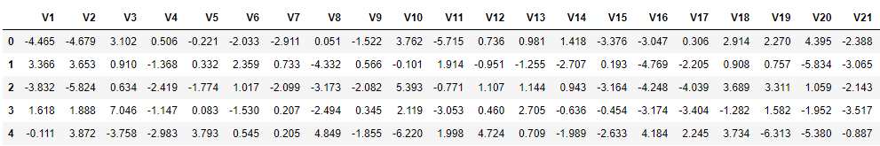
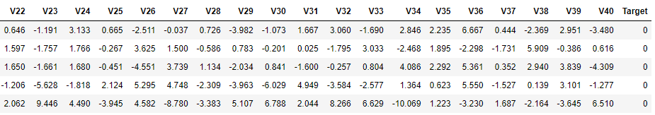
Data Preprocessing
Let’s take a quick look at a small sample of our data. This will help us get some idea of the attributes of the data and also help us understand the degree of cleaning needed before we can build a model.
Random sample of the data (5 rows, 41 columns):

Slide 9
Data Preprocessing
Duplicate Value Check: No duplicate entries were found in the given data
Missing Value Treatment:
Training Data had 18 missing values in V1 & V2 – We treat the missing values by imputing them with the medians of the variables V1&2
Testing Data had 5 missing values in V1 and 6 in V2 – We treat the missing values by imputing them with the medians of the variables V1&2
Outlier Check:
Since we don’t have the information and knowledge about what the variables actually are we cant treat any outliers and also note that EDA shows that there are no extreme outliers in any of the variables. Also, since this data was extracted from the sensors installed on the turbines we can assume that all the variables have accurate real readings.
Feature Engineering:
There was no need for feature engineering.

Slide 10
Model Performance Summary
Overview of ML model and its parameters
Model building
Model tuning
Model comparison
Final model selection & testing
Building pipeline for final model
Link to Appendix slide on model assumptions

Slide 11
Model Performance Summary
Overview of ML model:
ReneWind requires an intuitive model to predict based on the different variable readings provided by the sensors on their wind turbine which of the turbines are likely to fail. This is a classification problem so we will train and test ML models to find the best model for ReneWind.
ML model parameters:
Model Building: We split the ‘Training’ Data given to us into two parts – Training and Validation Data in a 75:25 ratio then, train six models for classification on 3 different types of training and validation data listed below and compare the results of the 18 Models. Models Used: Logistic Regression, Bagging, Random Forest, Gradient Boosting, Ada Boosting, XG Boost
Original Data
Over-sampled Data
Under-sampled Data
Model Evaluation Criterion: The nature of predictions made by the classification model will translate as follows:
True positives (TP) are failures correctly predicted by the model.
False negatives (FN) are real failures in a generator where there is no detection by model.
False positives (FP) are failure detections in a generator where there is no failure.
Which case is more important?
We need to choose the metric which will ensure that the maximum number of generator failures are predicted correctly by the model.
We would want Recall to be maximized as greater the Recall, the higher the chances of minimizing false negatives.
We want to minimize false negatives because if a model predicts that a machine will have no failure when there will be a failure, it will increase the maintenance cost.

Slide 12
Model Performance Summary
Model Building:
Original Data: Using the data of 20,000 records as given to us by ReneWind in the ‘Train.csv’ file we trained 6 of the selected models and obtained recall scores for all. XG Boost was found to be the best performing model with the highest recall score on the validation data set.
Over-sampled Data: Before oversampling we had only 5.5% data for the failure scenario of the turbines which meant less data. Using SMOTE (Synthetic Minority Over Sampling Technique) we over sampled our data giving us a total of 28,336 records of which 14,168 were now for failure label and 14,168 for healthy label, before oversampling the count was 832 and 14,168 for the failure and healthy labels respectively.
We trained the exact same models on our over-sampled data set and found Gradient Boost Model to have the highest recall scores on the validation data set.
Under-sampled Data: As opposed to overpopulating our data set in over-sampling we scale down the records for the healthy label records to that of the failure label records and we are left with 832 to samples for each label. Training our models yet again on our under-sampled data we see that XG Boost has the best recall score on the validation data set.
Model Tuning:
We tuned the hyperparameters of the following models based on the performance factors like recall score, accuracy and consistency between the train and validation set on the 3 different data sets(Their performance is provided in the Appendix):
AdaBoost w/ Over-sampled Data
Random Forest w/ Under-sampled Data
Gradient Boost w/ Over-sampled Data
XG Boost w/ Over-sampled Data

Slide 13
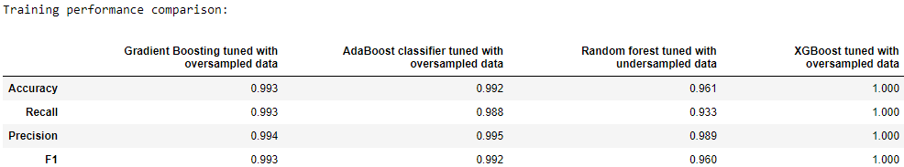
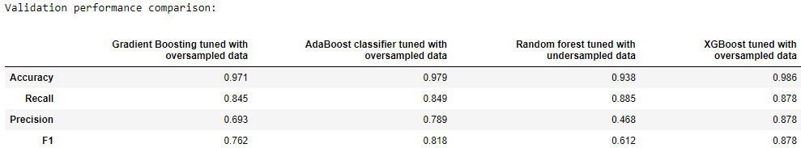
Model Performance Summary
Model Comparison:
Conclusion:
Since our objective is to maximize recall we can note that the highest recall on the validation data set was for the tuned random forest with under-sampled data(Recall = 0.885)

Slide 14
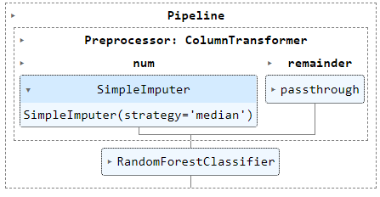
Model Performance Summary
Final Model Testing:
The model that was selected was the Tuned Random Forest as it had the highest recall score compared to all the other tuned model. The model was then tested against the unseen test data provided by ReneWind in the ‘Test.csv’ file and it yielded a recall score of 0.879 with an accuracy of 0.944. Other performance metrics are provided in the appendix.
Building Model Pipeline:
Then using Pipeline from sklearn library we built a the pipeline for our best model the tuned random forest model with the imputer step as the preprocessor step. Since we had only numerical values we did not need to impute any categorical features.
Trained and tested the pipeline and we got a recall score of 0.872.

Slide 15
APPENDIX A – EDA Results

Slide 16
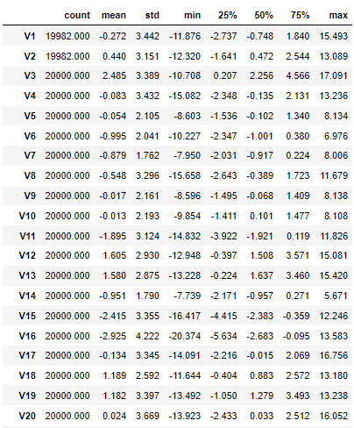
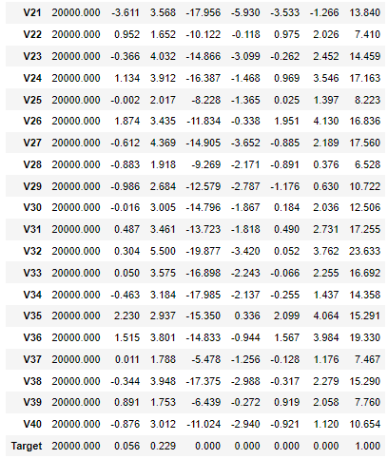
APPENDIX A: Statistical Summary

Slide 17
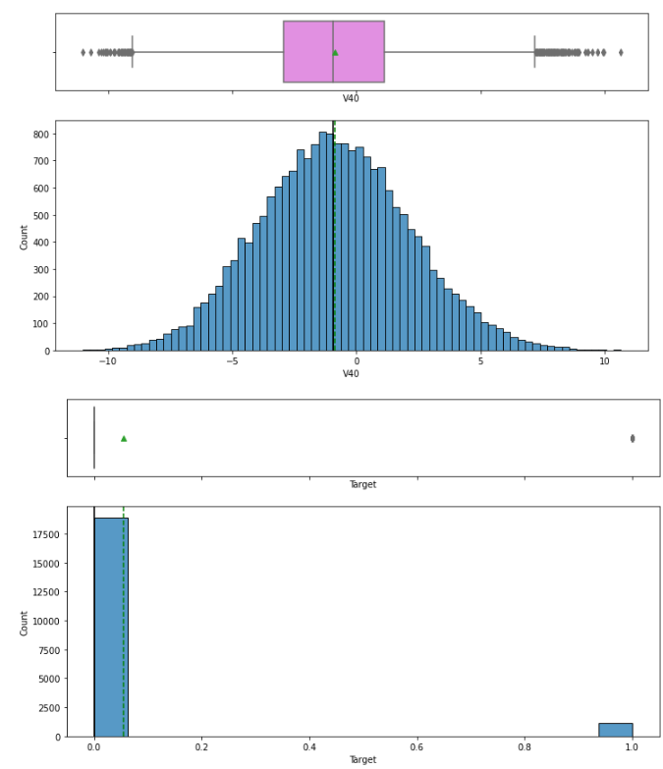
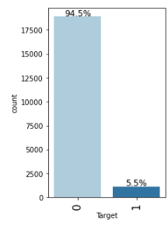
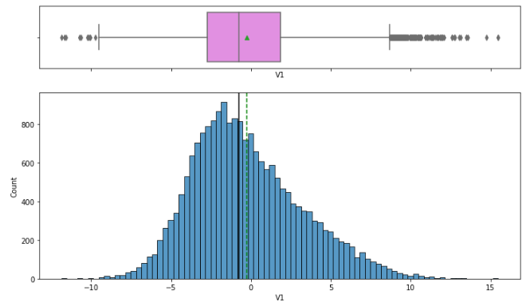
APPENDIX A: Univariate Analysis

Slide 18
APPENDIX A – EDA Results (Bivariate Analysis)

Slide 19
APPENDIX A: Bivariate Analysis

Slide 20
APPENDIX A: Bivariate Analysis

Slide 21
APPENDIX B – Model Performance Summary

Slide 22
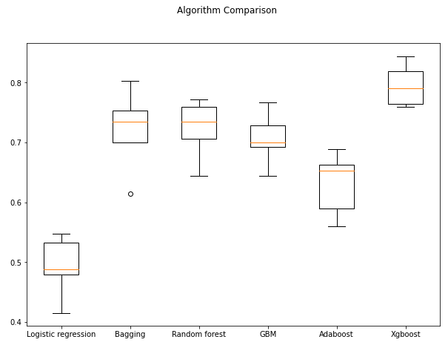
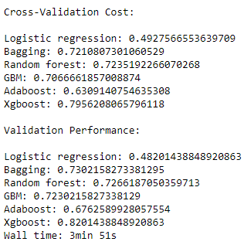
Original Data Model Comparison

Slide 23
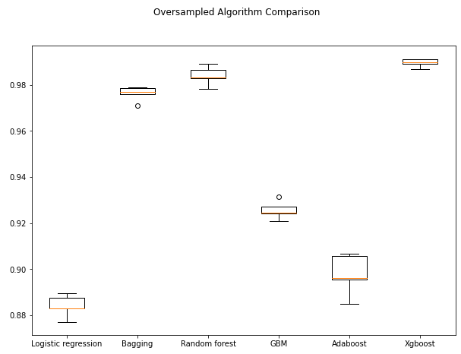
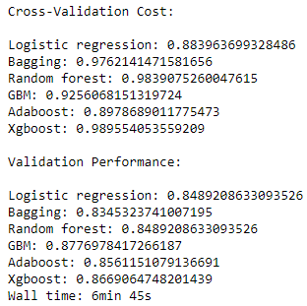
Over-Sampled Data Model Comparison

Slide 24
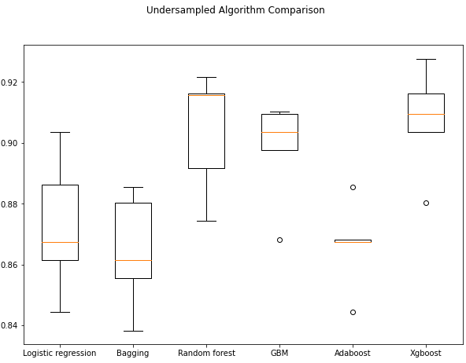
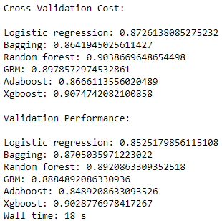
Under-Sampled Data Model Comparison

Slide 25
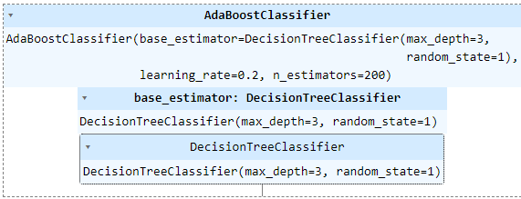
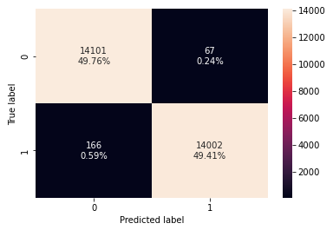
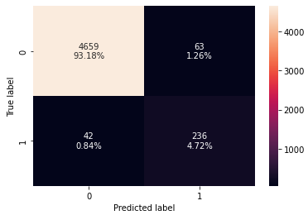
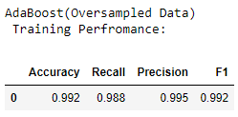
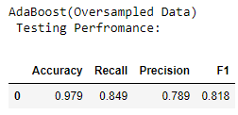
Tuned Ada Boost using over-sampled data

Slide 26
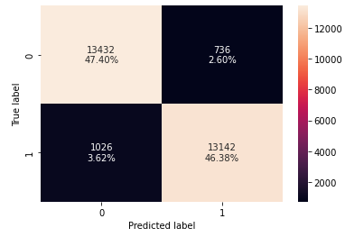
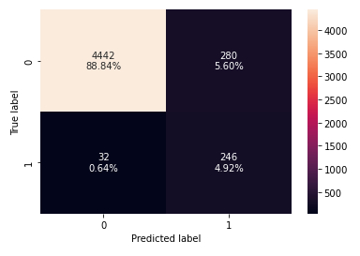
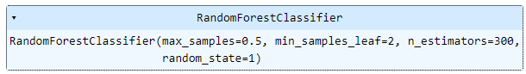
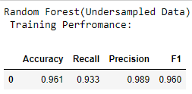
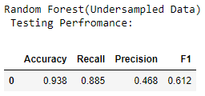
Tuned Random Forest using under-sampled data

Slide 27
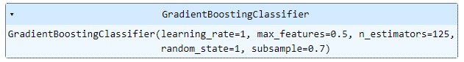
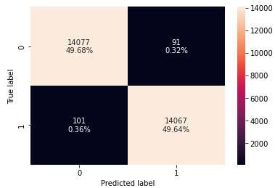
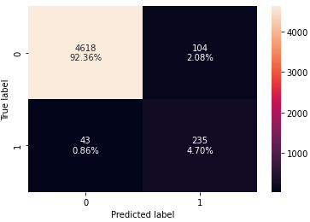
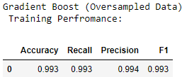
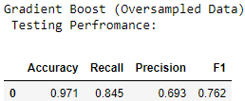
Tuned Gradient Boost using over-sampled data

Slide 28
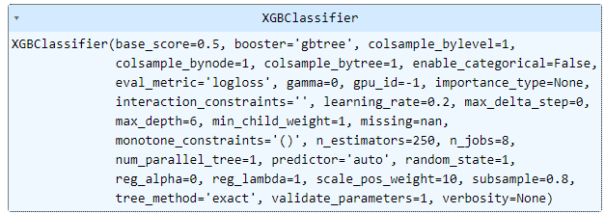

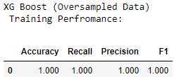
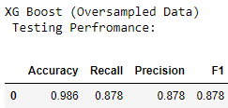
XG Boost using over-sampled data

Slide 29
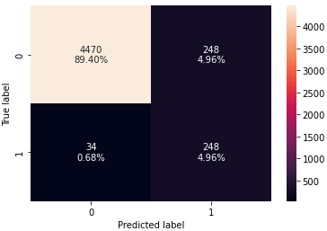
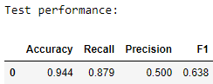
Final Model Testing: Tuned Random Forest

Slide 30
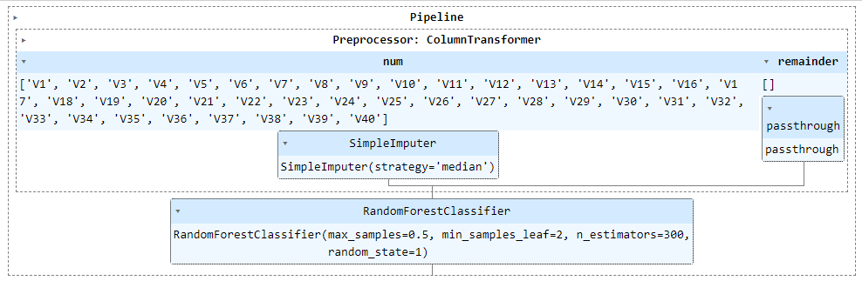
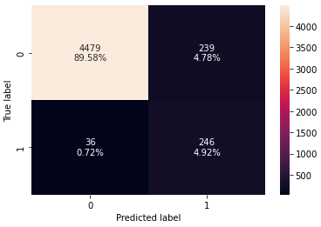
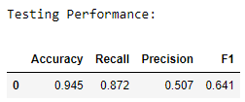
Final Model Pipeline

Slide 31
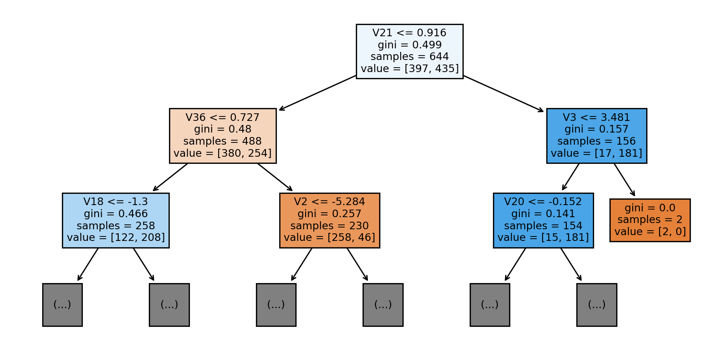
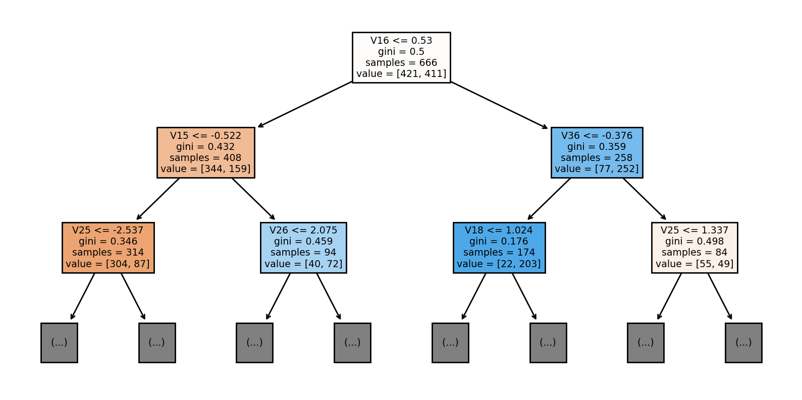
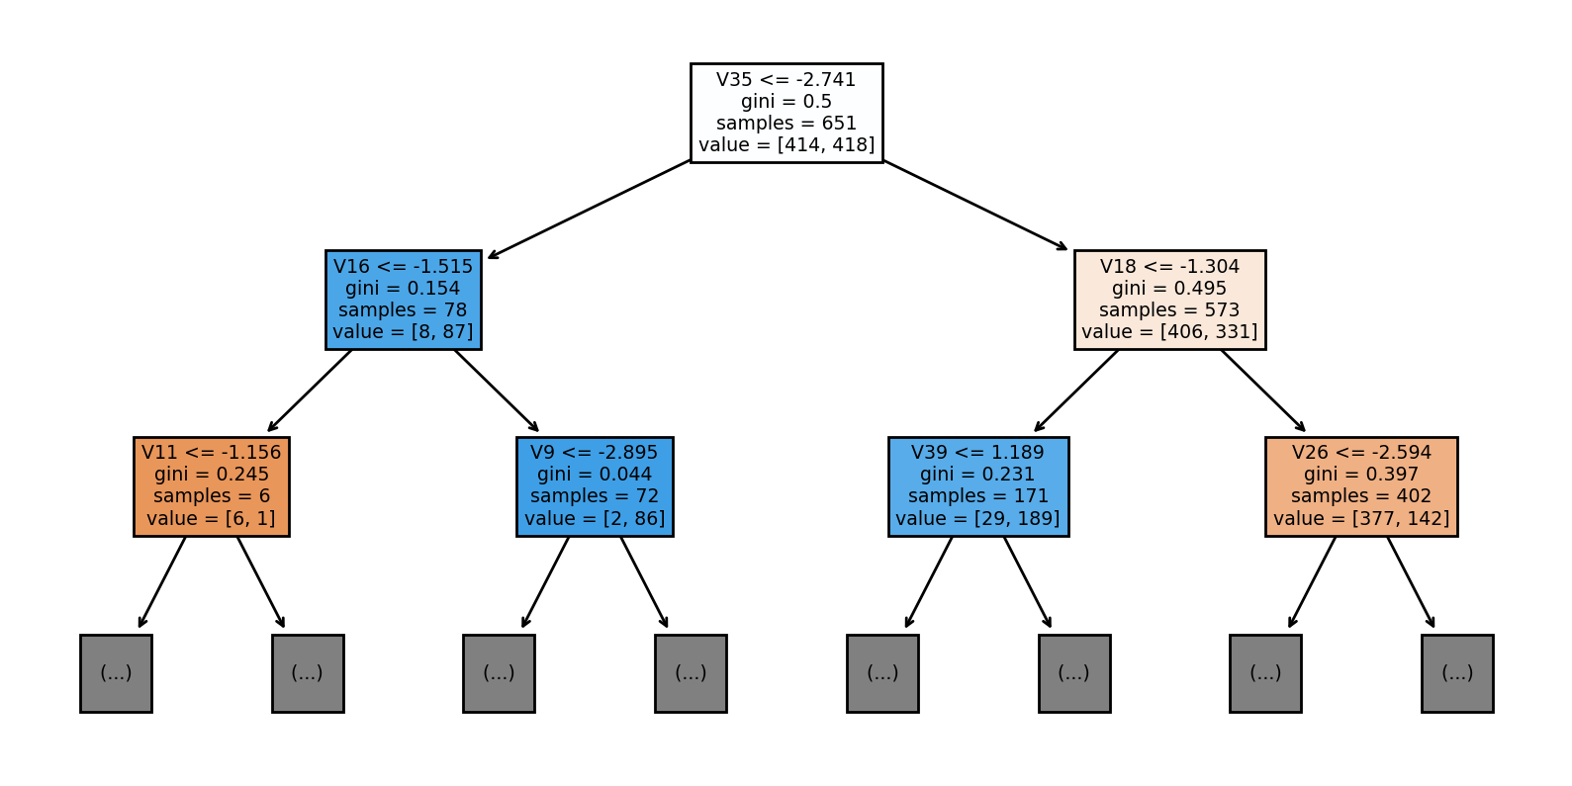
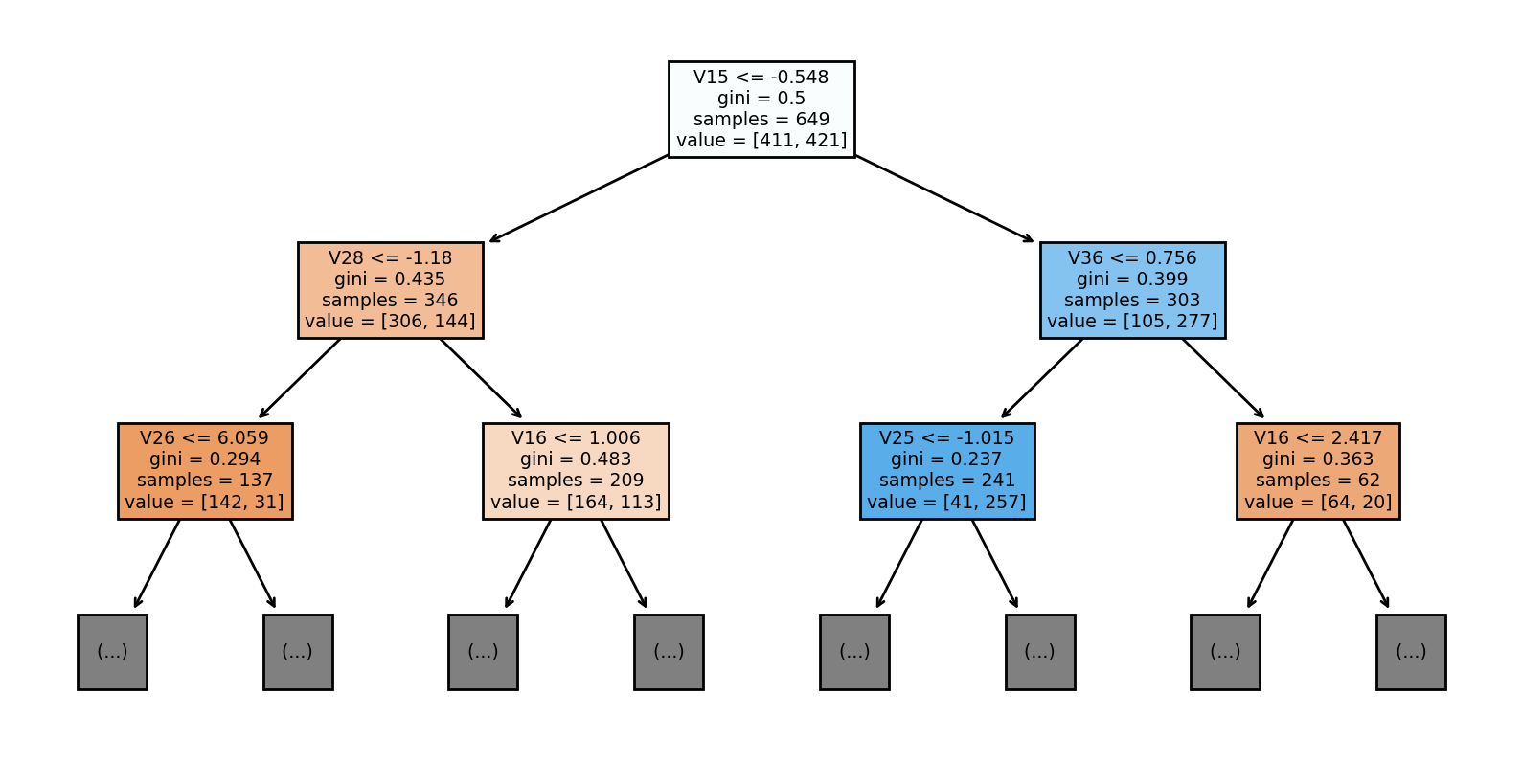
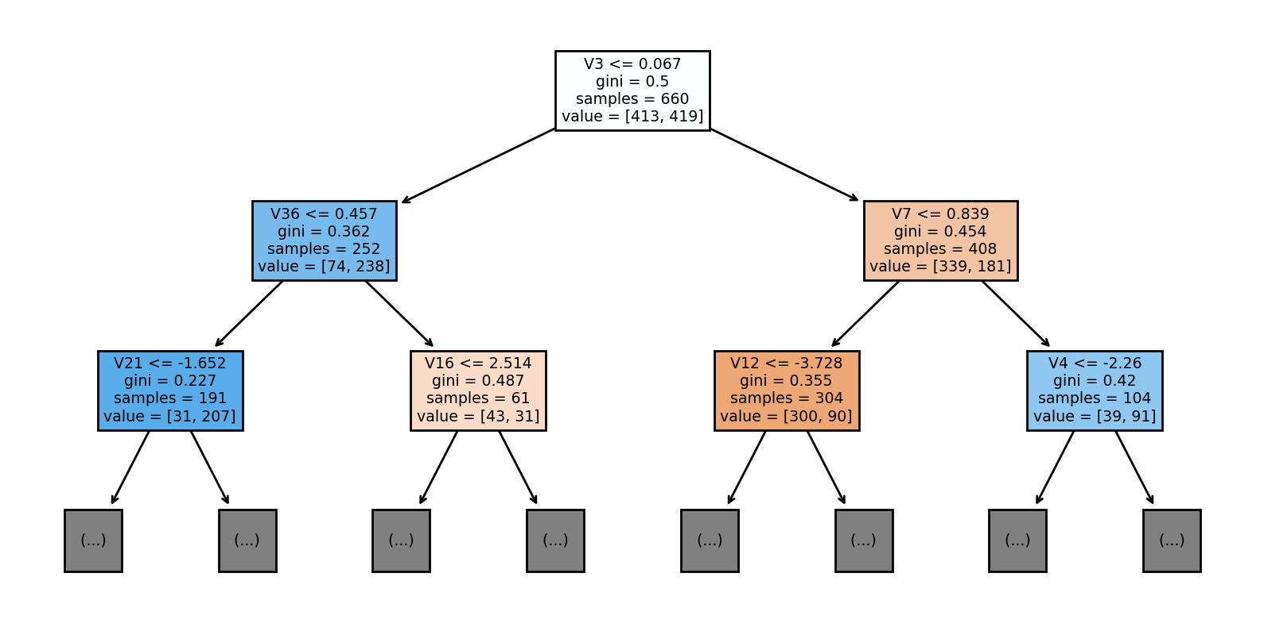
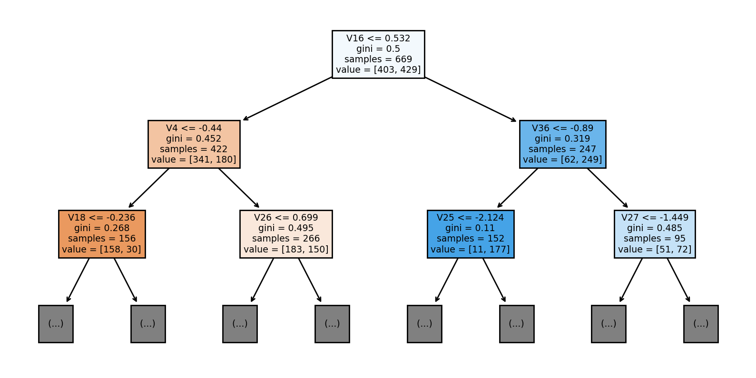
Final Mode: Decision Trees from Random Forest Model

